Slide 1
SPECTRAL ALGORITHM
CLUSTERING ALORITHMS

Slide 2
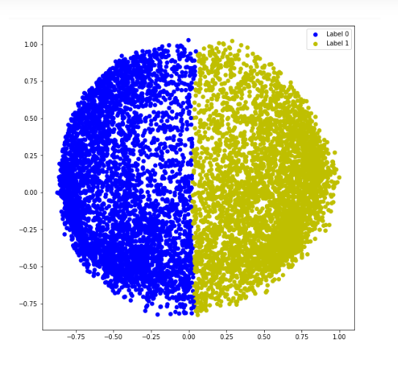
What is Spectral Clustering?
Definition: A clustering technique that uses the eigenvalues of a similarity matrix to reduce dimensionality before applying clustering algorithms.
Key Features:
Effective for identifying complex cluster structures.
Works well with non-convex shapes.
Key Concepts of Spectral Clustering
Graph Representation: Data points as nodes in a graph, edges represent similarities.
Laplacian Matrix: Derived from the similarity matrix to help define clusters.
Eigenvalues and Eigenvectors: Used for dimensionality reduction and forming clusters.

Slide 3
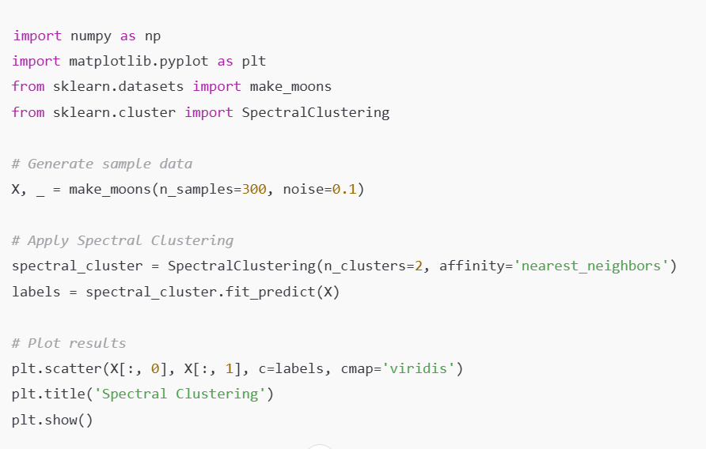
SPECTRAL in scikit-learn
Examples:

